Slide 1
ECE314 Lab 12 Overview
SIR model for epidemics

Slide 2
Applications
Spread of a biological virus in population
Spread of a computer virus in a computer network
Spread of an idea in a social network
How can we predict and control the spreading of viruses/ideas in those scenarios?

Slide 3
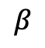
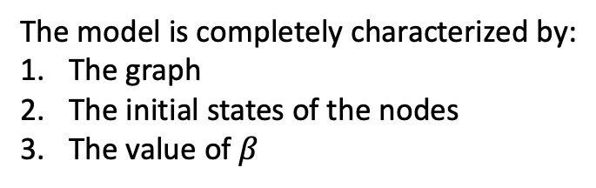
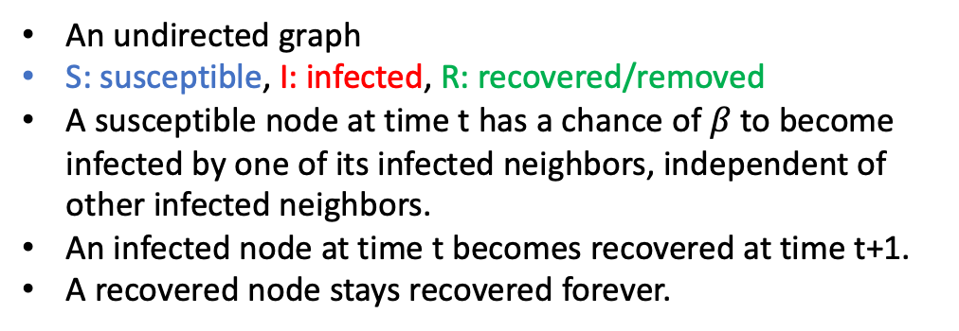
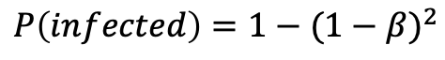
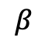
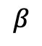
Basic SIR model
An undirected graph
S: susceptible, I: infected, R: recovered/removed
A susceptible node at time t has a chance of $β$ to become infected by one of its infected neighbors, independent of other infected neighbors.
An infected node at time t becomes recovered at time t+1.
A recovered node stays recovered forever.
$$P\left(infected\right)=1−{(1−β)}^{2}$$
$$β$$
$$β$$
The model is completely characterized by:
The graph
The initial states of the nodes
The value of $β$
$$β$$

Slide 4
Basic SIR model
An undirected graph
S: susceptible, I: infected, R: recovered/removed
A susceptible node at time t has a chance of $β$ to become infected by one of its infected neighbors, independent of other infected neighbors.
An infected node at time t becomes recovered at time t+1.
A recovered node stays recovered forever.
The model is completely characterized by:
The graph
The initial states of the nodes
The value of $β$

Slide 5
Basic SIR model
An undirected graph
S: susceptible, I: infected, R: recovered/removed
A susceptible node at time t has a chance of $β$ to become infected by one of its infected neighbors, independent of other infected neighbors.
An infected node at time t becomes recovered at time t+1.
A recovered node stays recovered forever.
The model is completely characterized by:
The graph
The initial states of the nodes
The value of $β$

Slide 6
Basic SIR model
An undirected graph
S: susceptible, I: infected, R: recovered/removed
A susceptible node at time t has a chance of $β$ to become infected by one of its infected neighbors, independent of other infected neighbors.
An infected node at time t becomes recovered at time t+1.
A recovered node stays recovered forever.
The model is completely characterized by:
The graph
The initial states of the nodes
The value of $β$

Slide 7
Basic SIR model
An undirected graph
S: susceptible, I: infected, R: recovered/removed
A susceptible node at time t has a chance of $β$ to become infected by one of its infected neighbors, independent of other infected neighbors.
An infected node at time t becomes recovered at time t+1.
A recovered node stays recovered forever.
The model is completely characterized by:
The graph
The initial states of the nodes
The value of $β$

Slide 8
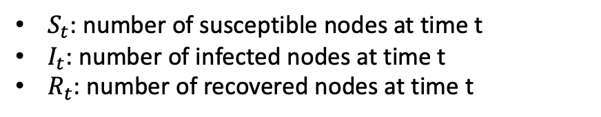
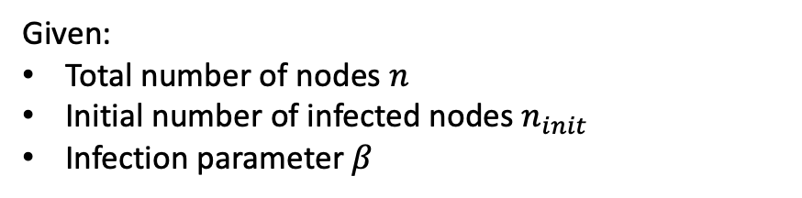
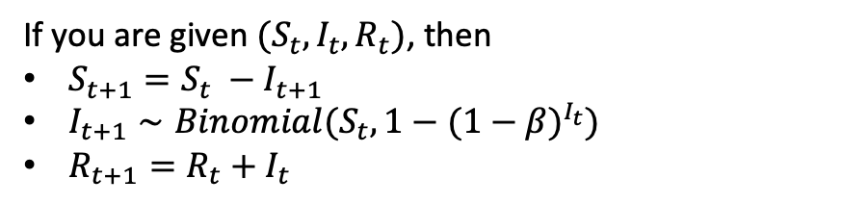
Simulation on a complete graph
Given:
Total number of nodes $n$
Initial number of infected nodes $n_{init}$
Infection parameter $β$
$S_{t}$: number of susceptible nodes at time t
$I_{t}$: number of infected nodes at time t
$R_{t}$: number of recovered nodes at time t
Markov process
If you are given $(S_{t}, I_{t}, R_{t})$, then
$S_{t+1}=S_{t} −I_{t+1}$
$I_{t+1}∼Binomial(S_{t}, 1−{(1−β)}^{I_{t}})$
$R_{t+1}=R_{t}+I_{t}$

Slide 9
Basic SIR model
An undirected graph
S: susceptible, I: infected, R: recovered/removed
A susceptible node at time t has a chance of $β$ to become infected by one of its infected neighbors, independent of other infected neighbors.
An infected node at time t becomes recovered at time t+1.
A recovered node stays recovered forever.
The model is completely characterized by:
The graph
The initial states of the nodes
The value of $β$

Slide 10
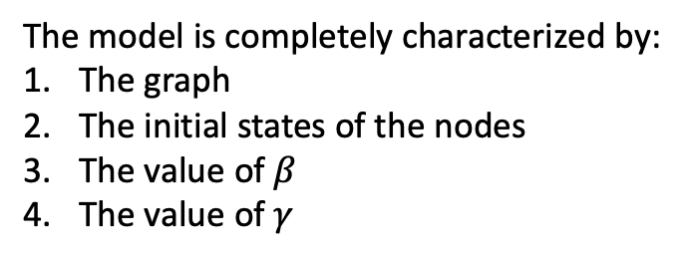
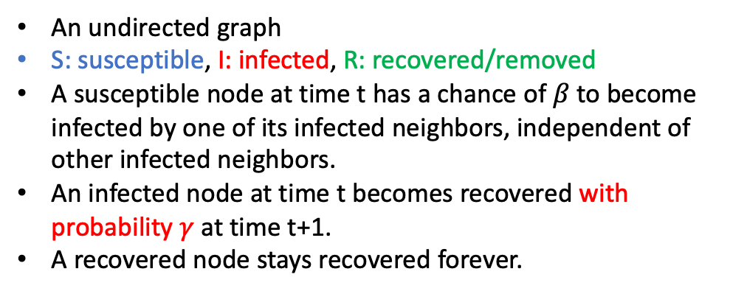
Improved SIR model
An undirected graph
S: susceptible, I: infected, R: recovered/removed
A susceptible node at time t has a chance of $β$ to become infected by one of its infected neighbors, independent of other infected neighbors.
An infected node at time t becomes recovered with probability $γ$ at time t+1.
A recovered node stays recovered forever.
The model is completely characterized by:
The graph
The initial states of the nodes
The value of $β$
The value of $γ$

Slide 11

ODEs of the SIR model for complete graph
$$\frac{dS}{dt}=−βIS$$
$$\frac{dI}{dt}=βIS−γI$$
$$\frac{dR}{dt}=γI$$
This is a good approximation for small $β$.

Slide 12
More simulations
Simulation on a random graph
Simulation on a graph obtained from real world data: a graph of blogs with links among them

